Slide 1
Product Planning
Teaching materials to accompany:
Product Design and Development
Chapter 4
Karl T. Ulrich and Steven D. Eppinger
5th Edition, Irwin McGraw-Hill, 2012.

Slide 2
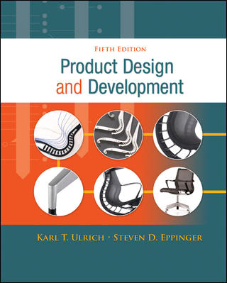
Product Design and Development
Karl T. Ulrich and Steven D. Eppinger
5th edition, Irwin McGraw-Hill, 2012.
Chapter Table of Contents:
Introduction
Development Processes and Organizations
Opportunity Identification
Product Planning
Identifying Customer Needs
Product Specifications
Concept Generation
Concept Selection
Concept Testing
Product Architecture
Industrial Design
Design for Environment
Design for Manufacturing
Prototyping
Robust Design
Patents and Intellectual Property
Product Development Economics
Managing Projects

Slide 3
Product Development Process
Planning
Concept
Development
System-Level
Design
Detail
Design
Testing and
Refinement
Production
Ramp-Up
Four Phases of Product Development
The product planning phase precedes the product development process.

Slide 4
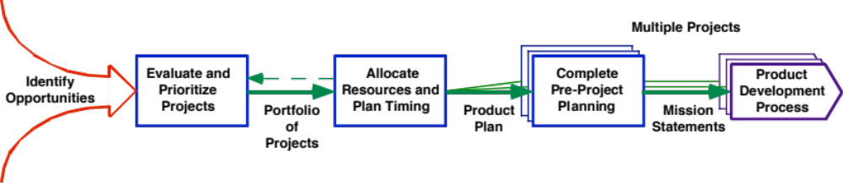
The Product Planning Process

Slide 5
Outline
Product Plan
Problems with no product plan
Project’s Mission Statement
Product Planning Process

Slide 6
Product Plan
Portfolio of products to be developed by the organization and the timing of their introduction to the market.
A set of projects approved by the planning process, sequenced in time

Slide 7
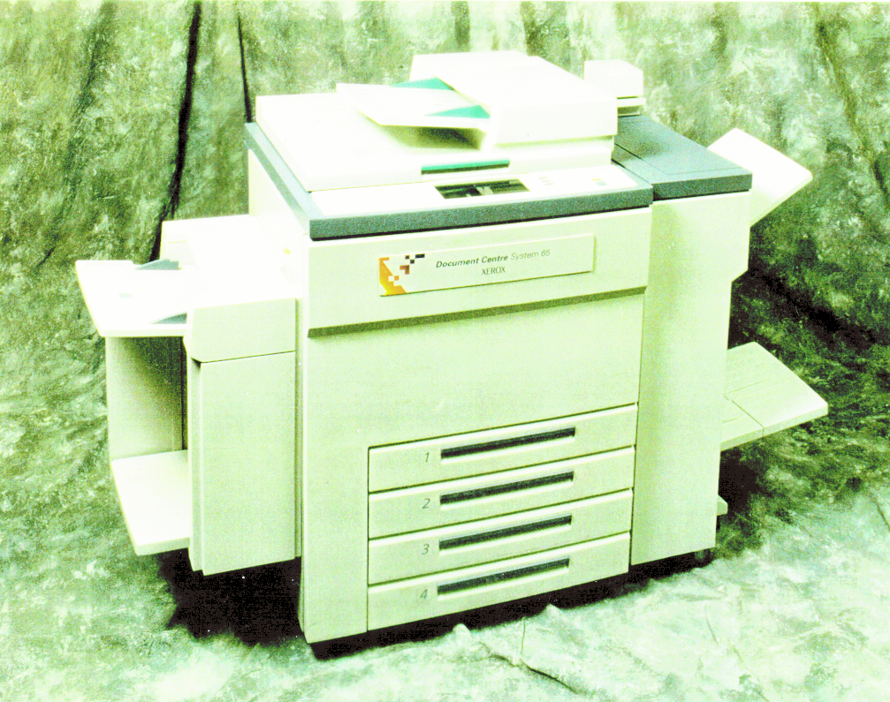

Xerox Lakes Project Example
Xerox Document Centre 265

Slide 8
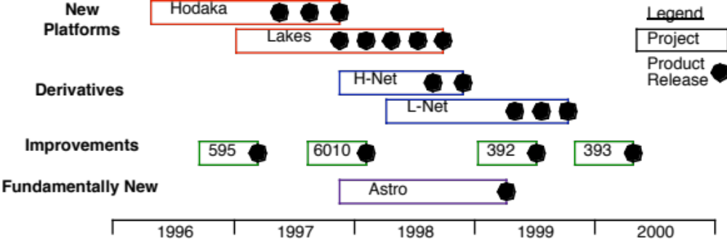
A Product Plan

Slide 9
Problems with no product plan
Inadequate coverage of target markets with competitive products
Poor timing of market introduction of products
Poor capacity planning and under-utilizing or development resources.
Initiation and cancellation of ill-conceived projects
Frequent changes in project directions.

Slide 10
Four types of product development projects
Fundamentally new products
  New product or production technology for new and unfamiliar markets
New product platforms
  New products for familiar markets and product categories
Derivatives of existing product platforms
  Use existing product platforms to better address familiar markets with new products.
Incremental improvements to existing products
  Only add or modify some features of existing products to keep the product line current and competitive

Slide 11
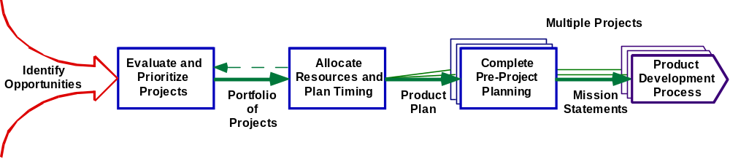
The Product Planning Process

Slide 12
Product Planning Questions
What product development projects will be undertaken?
What mix of fundamentally new products, platforms, and derivative products should be pursued?
How do the various projects relate to each other as a portfolio
What will be the timing and sequence of the projects?

Slide 13
The Product Planning Process
Identify & select opportunities
Evaluate and prioritize projects
  Product/project portfolio
Allocate resources and plan timing
  Product/project plan
Complete pre-project planning
  Product/project mission statement
Reflect on the results and the process.

Slide 14
1. Identify opportunities, from
Marketing and sales personnel
Research and technology development organizations
Current product development teams
Manufacturing and operations organizations
Current and potential customers
Third parties such as suppliers, inventors, and business partners

Slide 15
2. Evaluate and prioritize projects
- 2.1 for existing platforms or markets, depend on
Competitive strategy, by focusing on at least one of the following
  Technology leadership (R&D)
  Cost leadership
  Customer focus
  Imitative (lead time leadership)
Market segmentation
  Divide the market into segments in order to be more focused on the customer and competitors
Technological trajectories
  Consider when to adopt a technology in its S-shape curve of use.
Product platform planning
  Product platform: a set of assets such as components and subassemblies, shared across a set of products in the company
  Platform development projects may take 2-10 times as much time and money as derivative product development projects
  Technology roadmap is usually used to represent the expected availability and future use of various technologies relevant to the product being considered. See a roadmap in EX4-7 on page 62.

Slide 16
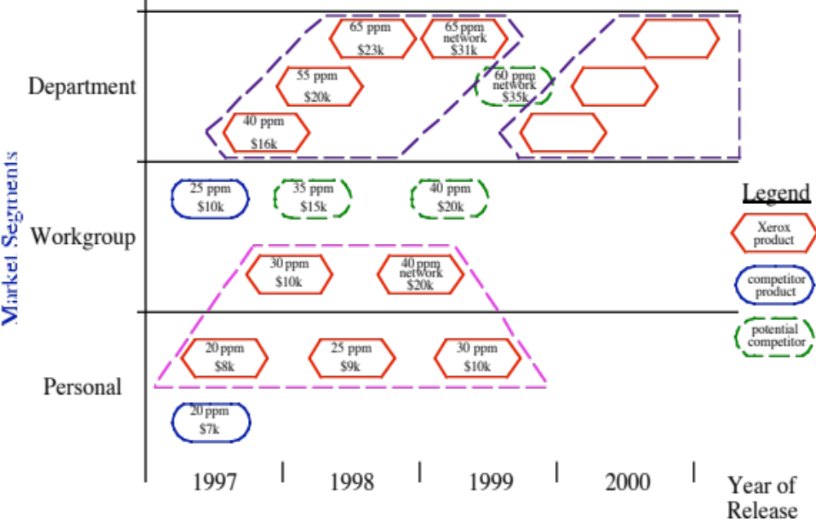
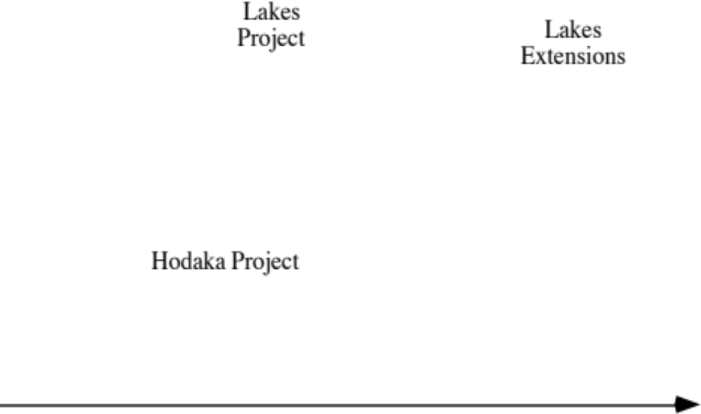
Market Segment Map
Market Segment

Slide 17
Technology S-Curves
Digital
Technology
Copier Performance
Light-Lens
Technology
Time

Slide 18
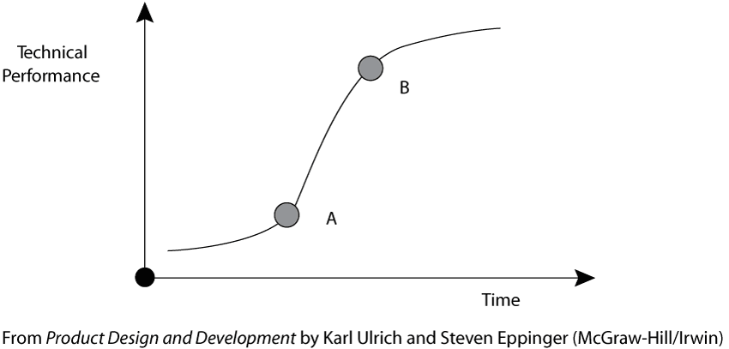

Slide 19
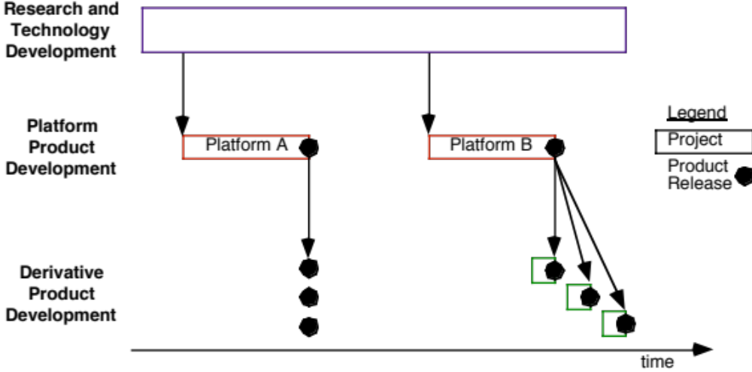
Platforms vs. Derivatives

Slide 20
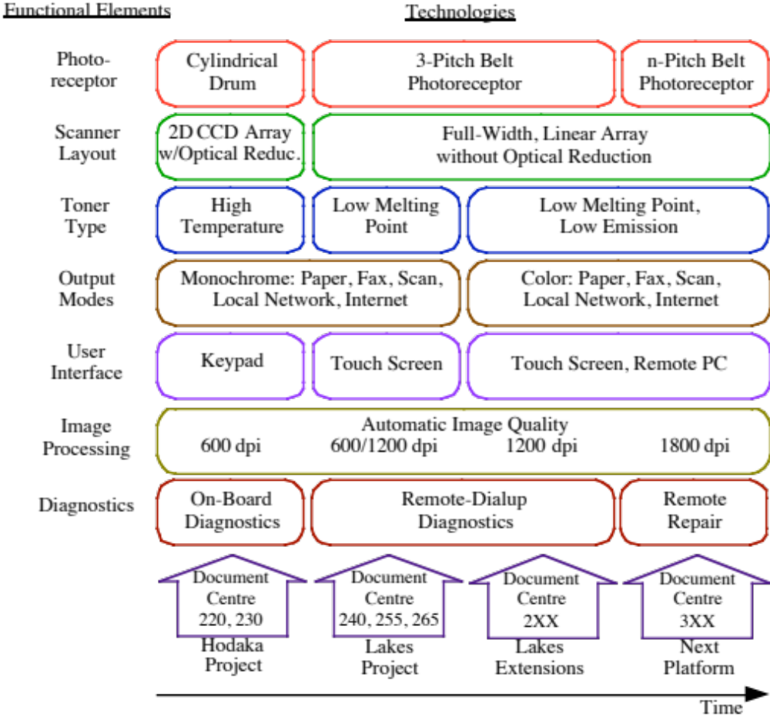
Technology Roadmap

Slide 21
2. Evaluate and prioritize projects
- 2.2 For new markets or new technologies, consider
Market size (annual sales x unit price)
Market growth rate
Competitive intensity (competitors and their strength)
Depth of the firm’s existing knowledge of the market.
Depth of the firm’s existing knowledge of the technology
Fit with the firm’s other products
Fit with the firm’s capabilities
Potential for patents, trade secrets, and other barriers for competitors to enter
Existence of product champion within the firm

Slide 22
2. Evaluate and prioritize projects
- 2.3: balance the portfolio
The choice of competitive strategy affects the product development portfolio
Use of the product-process change matrix to balance the portfolio, as shown in page 63.
Product development is closely coupled with technology development, though it is usually not in the company’s control.

Slide 23
Product-Process Change Matrix
Extent of Production Process Changes
Research and
New
Next
Single
Tuning and
No
Technology
Core
Generation
Department
Incremental
Process
Development
Process
Process
Upgrade
Changes
Change
New
Breakthrough
Core
Development
Product
Projects
Platform
Next
Development
Generation
Projects
Product
Lakes
Project
Addition
Extent of Product Changes
to Product
Family
Derivative
Product
Minor
Development
Product
Enhancement
No
Current
Product
Product/Process
Change
Support

Slide 24
3. Allocate resources and plan timing
Every company has finite resources
It estimates resource requirements for each project in the plan by month, quarter, or year.
The resources plan is usually prepared at aggregate level by major resource categories, as shown on page 65
The effort of resource planning and project timing should also consider:
  Timing for product introduction
  Technology readiness
  Market readiness
  Competition

Slide 25
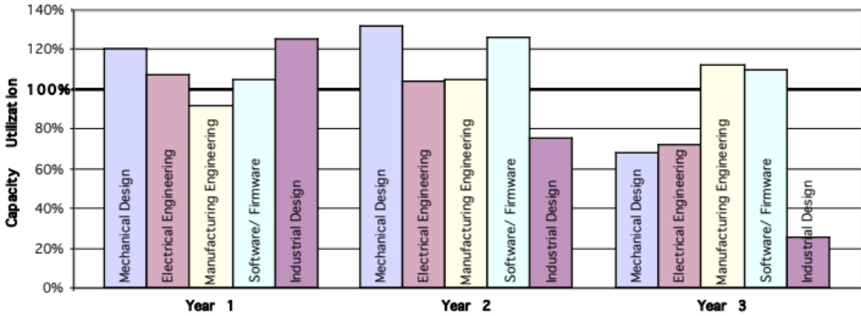
Aggregate Resource Planning

Slide 26
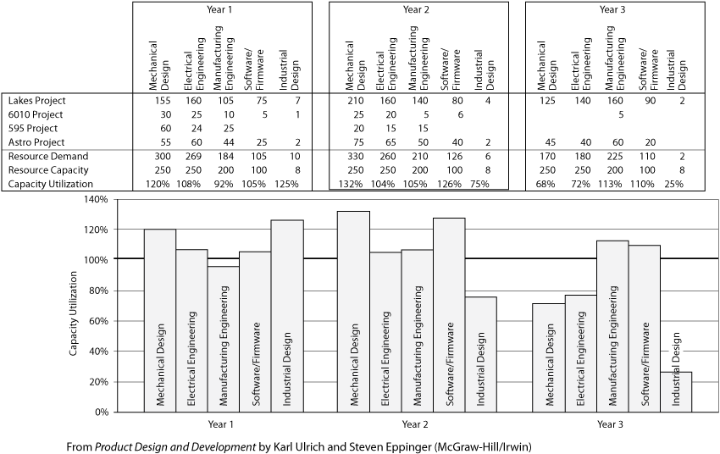

Slide 27
4. Complete pre-project planning
Finalize a mission statement for each project (shown on page 67) that includes
  A brief (one sentence) description of the product
  Major benefit proposition
  Key business goals
  Primary and secondary markets for the product
  Assumptions and constraints for the development effort
  Stakeholders
Sign up key members of the development staff

Slide 28
Project’s Mission Statement
Market segments to be considered for the product design and its features.
New technologies (if any) to be incorporated into the new product
Manufacturing and service goals and constraints
Financial targets for the product design
Budget and time frame for the project

Slide 29
Lakes Project Mission Statement
Product Description
Networkable, digital machine with copy, print, fax, and scan functions
Key Business Goals
Support Xerox strategy of leadership in digital office equipment
Serve as platform for all future B&W digital products and solutions
Capture 50% of digital product sales in primary market
Environmentally friendly
First product introduction 4thQ 1997
Primary Market
Office departments, mid-volume (40-65 ppm, above 42,000 avg. copies/mo.)
Secondary Markets
Quick-print market
Small ‘satellite’ operations
Assumptions and Constraints
New product platform
Digital imaging technology
Compatible with CentreWare software
Input devices manufactured in Canada
Output devices manufactured in Brazil
Image processing engine manufactured in both USA and Europe
Stakeholders
Purchasers and Users
Manufacturing Operations
Service Operations
Distributors and Resellers

Slide 30
5. Reflect on the result and process
Does the opportunity funnel generate good product opportunities?
Does the product plan support the firm’s competitive strategy?
Does the product plan address the most important opportunities?
Does each project core team accept the challenge as stated in mission statement?
Are resources sufficient and effectively utilized?

